Slide 1

HPC N-Body Simulation
Accelerating Astrophysical Compute with OpenMP & SIMD
Kuruv Patel (U23AI051)
Jeet Gupta (U23AI056)
Akshat Agrawal (U23AI013)
Kalp Sheladiya (U23AI001)

Slide 2






Project Overview
The Physics
The Compute
The Goal
Simulating the complex gravitational interactions of 1000+ celestial bodies orbiting a central star using Newtonian mechanics and Euler integration.
Leveraging high-performance computing (HPC) techniques. Utilizing OpenMP for multithreading and SIMD instructions for rapid vector math execution.
Achieving significant speedup over sequential execution without compromising the accuracy of the planetary orbits. Comparing metrics to benchmark scaling.

Slide 3


The Physics Model
Universal Gravitation: Forces are computed between every pair of particles using Newton's inverse-square law.
Softening Parameter ( ): The variable prevents division by zero and near-collision singularities that cause unstable velocities.
Euler Integration: Time-stepping integration efficiently updates particle velocities based on accumulated forces, followed by positional updates using .

Slide 4



Algorithmic Optimization
•
The naive N-body calculation computes forces for every permutation, yielding an complexity.
•
By applying Newton's Third Law, we know that for every action, there is an equal and opposite reaction.
•
The inner loop is structured to start at .
•
When force is calculated for body , the negative of that force is immediately applied to body .
•
This slices the required gravitational force calculations exactly in half.

Slide 5


Memory Layout: SoA
Array of Structures (AoS)
Structure of Arrays (SoA)
A traditional object-oriented approach groups attributes (x, y, vx, vy, mass) into a single structure.
This code leverages isolated vectors for each property:
When iterating through coordinates, data is perfectly contiguous in memory. This maximizes cache utilization and is heavily favored by the compiler for generating efficient SIMD vectorization instructions.
When computing forces, the CPU only needs the x and y coordinates, but it loads the entire struct into the cache line. This wastes memory bandwidth and leads to frequent cache misses in high-performance loops.

Slide 6

Parallel Computation
Avoiding Atomic Bottlenecks
Because multiple threads update the same particle forces simultaneously (due to Newton's 3rd Law optimization), a race condition exists. Using on every single force addition would serialize the hardware and destroy performance.
The Solution: The code creates thread-local force arrays and threads compute and accumulate forces purely locally with zero locks.
Finally, a single block is used at the end to safely merge the thread-local arrays back into the global force array.

Slide 7
Load Balancing & SIMD
OMP
Dynamic Thread Scheduling
Because the inner loop runs from to , early iterations do massive amounts of work, while later iterations do almost none. Static scheduling would result in idle threads.
Scheduling Directives
By using , the runtime distributes chunks of 10 iterations to threads as they become available, keeping all cores saturated.
SIMD Vectorization
forces the compiler to process multiple loop iterations simultaneously within a single CPU vector register, compounding the performance gains.

Slide 8
Performance Analysis
Evaluating the computational speedup of our parallel design against a standard serial execution benchmark.

Slide 9
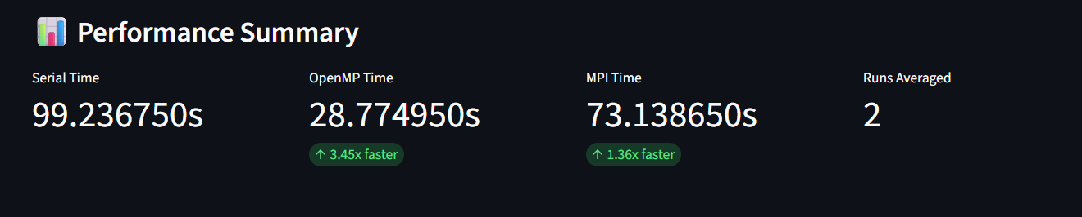
Serial vs. OpenMP Runtime
The OpenMP implementation demonstrates a massive reduction in simulation execution time. The localized array reduction and dynamic scheduling combined to effectively utilize all 8 physical CPU cores without lock contention overhead.

Slide 10

Simulation Output
The code outputs a continuous CSV stream mapping (step, x, y, mass). When plotted, this data visually represents our initialized random noise orbits, maintaining structural integrity across 10,000 computed timesteps.

Slide 11
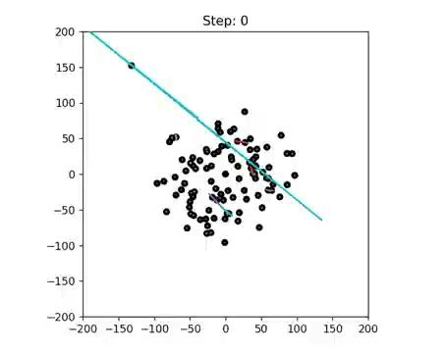
Questions?
Thank you for your attention.
N-Body Simulation compiled with -fopenmp -O3

Slide 12
THANK YOU

